Slide 1
Android Security Model

Slide 2
@me
Malware Analyst
In security since 2010
Can protect my WebApps
Try to stay below HTTP
badboy16a@gmail.com
@_badbot
PC Gamer

Slide 3
Agenda
Android
Versions
Flavors
Architecture
Kernel
Sandbox
Application
Runtime
Framework
ICC
Play Store
Security Incidents
Best Practices

Slide 4
Android?
An open source mobile OS.
Based on Linux kernel.
Originally developed by Android Inc.
Acquired by Google in 2005.
Development is controlled by Google.
Open Handset Alliance.
Notes:
The early intentions of the company were to develop an advanced operating system for digital cameras, when it was realized that the market for the devices was not large enough.
First product of open handset alliance.
More than a billion users.

Slide 5
Versions
1.6
Donut
2.0
2.2
Froyo
Éclair
1.5
Cupcake

Slide 6
Versions
3.0
Honeycomb
4.0
Ice Cream Sandwich
4.1
2.3
Gingerbread
Jelly Bean

Slide 7
Versions
4.3
Jelly Bean
4.4
KitKat
5.0
4.2
Jelly Bean
Lollipop

Slide 8
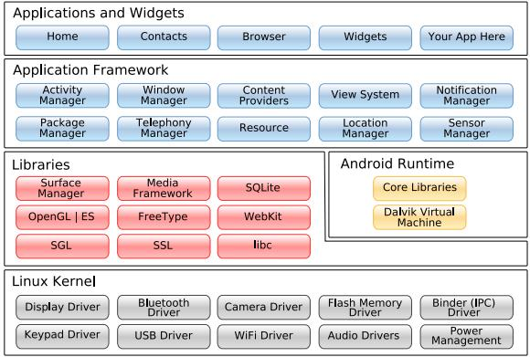
Architecture

Slide 9
Flavors
AOSP
The true open source version.
Published by Google/Open Handset Alliance
OEM Versions
Based on AOSP
Customizations by H/W manufacturer.
Custom ROMS
Based on AOSP
Customizations by community.

Slide 10
Kernel
Linux
32bit ARMv7
Support for 64bit, x86 with 5.0
Process Isolation
User based permission model
Extensible mechanism for secure IPC
Memory protections
ASLR
no non-PIE linker support.
dm-verity (Secure Boot)
Notes:
IPC
Binder
-Wformat-security : string format vulnerabilities
FORTIFY_SOURCE: uses length aware functions at compile time.
dm-verity : verifies integrity of /system.

Slide 11
Process
Run with limited privilege
Memory separation provided by kernel
Capability based privilege
Few processes with ‘root’ user
Decreasing with subsequent releases.
SELinux policy
Enforced
Permissive
No setuid/setgid binaries

Slide 12
Sandbox
Based on standard UNIX user separation
No java security extensions.
Every app becomes a user
Unique system uid, gid
Unique home directory
uid can be shared
Process can belong to multiple groups
Data sharing
Via IPC
Via world accessible files
Notes:
uid share if same signature.

Slide 13
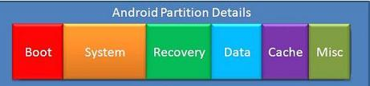
Storage
/data : User Data (read-write)
Installed Apps
Contacts
/system : System partition (read-only)
Android OS
Provider’s apps
/boot (read-only)
Kernel
ramdisk
/storage/sdcard0 (read-write)
External SD Card
Notes:
ext4 file system.
/data/data/app: home, same uid access.
Full disk encryption
On by default since 5.0

Slide 14
Application
A zlib compressed package
.apk extension
Code
Resources
Data
Cryptographically signed by developer.
Self generated certificate.
Developed in java
Compiled to dex format
Android runtime bytecode.

Slide 15
Permissions
Permissions define execution boundaries
Explicit request/declaration via AndroidManifest.xml
Permissions are granted at install time only
Permissions are enforced by android run-time
Custom permissions (not recommended)
Permission levels
Normal: Assigned by default
Dangerous: Explicit approval from user.
Signature: Automatically granted for app with same signature
SignatureOrSystem: granted to applications in /system
Notes:
Signature: signature same as declaring app
SignatureOrSystem: Used by phone vendors for inbuilt apps.

Slide 16
ICC
Android is based on Inter Component Communication
Components
Activity
Service
Broadcast Receiver
Content Provider
Intent
Explicit data sharing with intents
intent-filer to filter unwanted intents.

Slide 17
Framework
ART/Dalvik
Register based Virtual Machine
Forked for every app
Java
JVM
Android API
Android Run Time
Native Code
Permission

Slide 18
Native Code
C/C++ can be used for performance
Same security restrictions apply to native code.
Runs in same ART process space.
Uses JNI for bridge between Java and Native.

Slide 19
Google Play Store/Services
A review and reputation based market place.
Verification for side-load installs.
Identifies developers.
Updates for non-system apps
App screening by Google.
Update to system components
WebView (5.0)

Slide 20
Vulnerabilities
Master Key Vulnerability
Multiple file with same name.
Android Bowser SOP bypass
Also affects apps using WebView
Fake ID vunerability
No verification of issuer.
NFC Vulnerabilities
OpenSSL PRNG weaknesss
Notes:
Verification by one, Extraction by other.

Slide 21
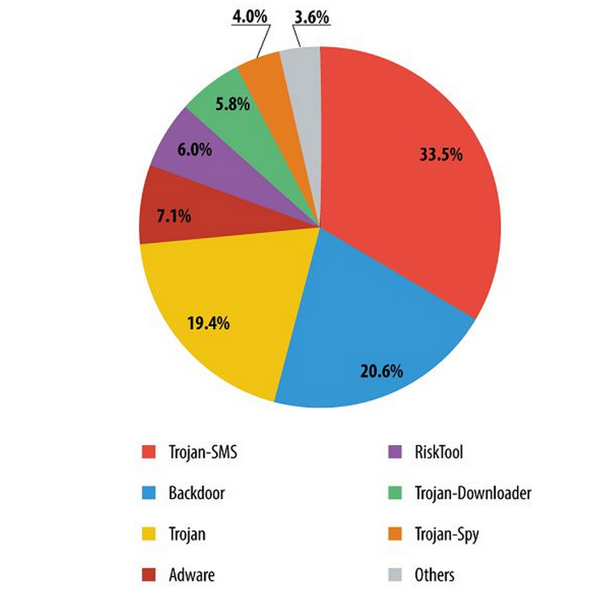
Malwares
Android malwares categories detected by Kasperkey Lab in 2013.

Slide 22
Best Practices :: User
Review and understand permissions before install.
Avoid apps that ask more permissions than it should.
Do not side–load apps.
Do not install from unauthorized App Stores.
Use official Google play store only.
Use disk encryption
Create a strong password/pin to unlock.
Disable usb-debugging and developer mode when not needed.

Slide 23
Best Practices :: Developer
Use obfuscation
Do not store sensitive data on external storage
Use cryptography properly.
Do not ask more permissions than required
Avoid defining custom permissions
Validate inputs
Prefer encrypted networking
Follow secure coding guidelines
Test security of apps before publishing

Slide 24

Thank you

